Slide 1
School education in Scotland
Pupil numbers by stage:
Average class size in primary is 23.4
Staying on rates have risen.
Over 88% of S3 cohort stay on to S5 and over 62% to S6.
Pupils
Teachers
Schools
Secondary - 361
Special - 144
Secondary - 23,000
Special - 1,900
Secondary - 282,000
Special - 7,000
Primary - 23,500
Primary - 391,000
Primary -2,039
12.2% of P1-P3 pupils are in a class of 18 or less
Pupil-teacher ratio is 16.7 in primary
Teacher workforce:
77% of all teachers are female
And 12.2 in secondary
84% of schools are in a good or satisfactory condition
3% of primary pupils are in schools with fewer than 50 pupils
Condition of schools:
Size of schools:
There are around 1,000 rural schools in Scotland.
Early learning and childcare
Around 120,000 2-5 year olds receive the entitlement to 600 hours free early learning and childcare
The free entitlement to 600 hours of free early learning and childcare is provided in nearly 2,500 nursery settings

Slide 2
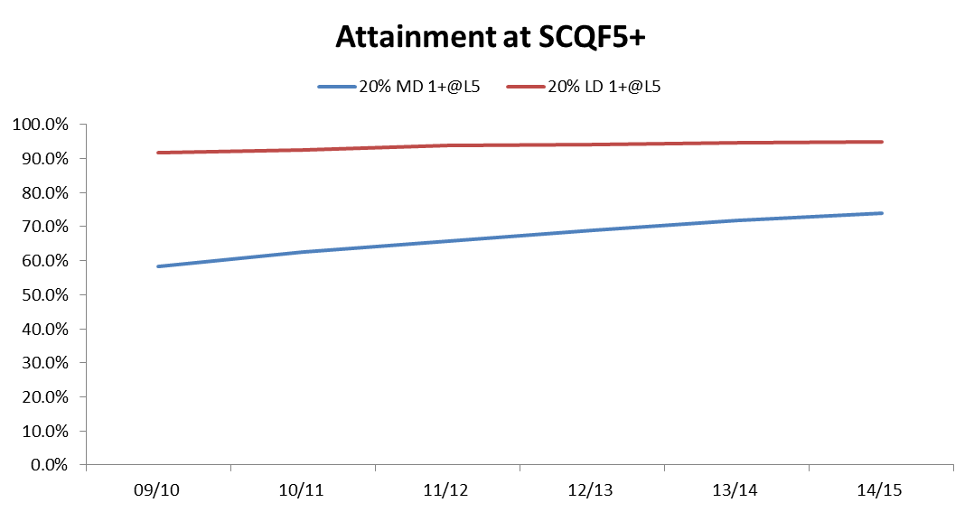
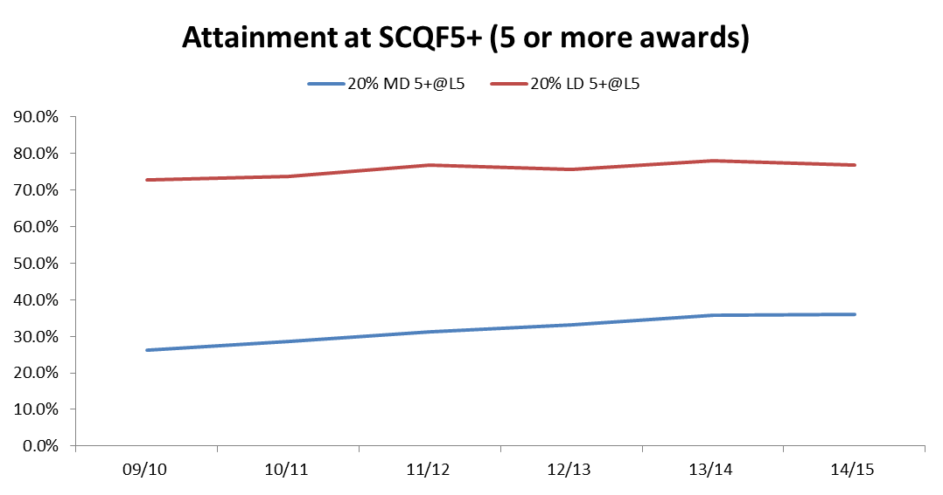
Attainment
No matter what data we use, or which aspect of attainment we look at, there is a clear gap between children from more deprived and less deprived backgrounds.
Attainment is rising:
Very few young people leave school with no or very low levels of qualifications (2.1% in 14/15)
152,701 Higher passes in 2016, up more than 40,000 since 2006
“There is significant variation in attainment between individual councils, schools and groups of pupils.”
Positive destinations for our young people are rising - 92% of 2014/15 school leavers were in a positive follow up destination in March 2016.
There are signs that the attainment gap is reducing on some measures.
There is an improving picture for those leaving school with low or no levels or qualification.
The difference in the proportions from the most and least deprived areas achieving at least one SCQF 5 qualification or better has reduced (33 percentage points in 09/10 to 21 points in 14/15.)
But the gap in terms of those achieving 5 or more awards at SCQF5 or better has decreased at a much slower rate (down 5.6 percentage points since 09/10).
The Scottish Survey of Literacy and Numeracy shows that:
The majority of P4 and P7 pupils are performing well or very well in literacy and numeracy...
...However there were small decreases in performance in reading and writing between 2012 and 2014 at the majority of stages.
...And a decreased numeracy performance between 2011 and 2015

Slide 3
Spending on education by local authorities
Education
Expenditure
Special schools
£533m
(11%)
Primary
£1,852 m
(38%)
Secondary
£1,929 m
(40%)
Other
£156 m
(3%)
Early Years and Childcare
£346 m
(7%)
Average spend per pupil of £6,790
Average spend per pupil of £4,814
Education is the largest service area – The 32 councils plan to spend 41% of service expenditure on education in 2016-17
Councils spent £4.8 bn on education in 2014-15
Over half of spend on primary, secondary and special education is on teachers
Running school buildings, school meals, school transport, textbooks etc, some elements of unitary charge payments
Average spend per child of around £2,900 a year
Services purchased to support delivery (e.g. IT or finance bought within an LA)
Average spend per pupil in primary, by local authority
There is wide variation between councils in spend per pupil
Island authorities
All non-teaching staff employed in schools and non-teaching staff employed by LA education services
All teachers in schools and those centrally employed by LAs

Slide 4
How is Education in Scotland run now?
The Scottish Government, local government, national agencies and other bodies each play different roles in governing, leading and supporting the delivery of education
Scottish College for Educational Leadership
Responsible for developing leadership and programmes
Children and Young People
Children have rights to be heard and involved in decisions about their education
Parents have a range of rights and responsibilities, including
Responsibilities to ensure their children: are properly educated at school age; attend school; obey school rules.
Rights to: children being educated in line with their religious/philosophical beliefs; to choose school; to be consulted and appeal against decisions on additional support needs.
Parent Councils represent the voice of parents in their school
8 Universities
Provide teacher education
Scottish Qualifications Authority
Develops school examinations and awards school qualifications
Also has responsibility for other qualifications (such as HNC’s)
Scottish Social Services Council
Regulator for the social service workforce
Early Years staff & Teachers
Deliver day to day care and learning to children in early years settings and schools
General Teaching Council for Scotland
Sets teaching standards
Accredits teacher training
Oversees induction, professional learning and student placement programmes
Child
Headteachers
Day to day running of school
Share responsibility with local authority for management and delivery of curriculum
Some funding decisions
Parents
Care Inspectorate
Regulates and inspects the standard of care services, including in early years, and residential schools
School
Local
Education Scotland
Supports quality and improvement
Responsible for supporting schools to deliver Curriculum for Excellence and for school inspection.
32 Local Authorities (as Education Authority)
Duty to provide “adequate and efficient” school education and early years provision
Employment of school and some early years staff
Decide how much money to give to schools
Number of other duties, for example; providing for additional support needs; consulting on school estate, arranging school transport, school opening, closing and holiday dates
National
Scottish Government
Develops national policy and sets overall direction
Gives majority of funding to local authorities for education
Legal duty to improve education and powers to raise standards
Legal duty to promote involvement of parents in education
Scottish Qualifications Authority
Develops school examinations and awards qualifications
Others
A range of other partners support children’s learning including private and third sector providers; local community organisations and charities as well as other local services such as social work, the police, employers, colleges and universities

